Slide 1
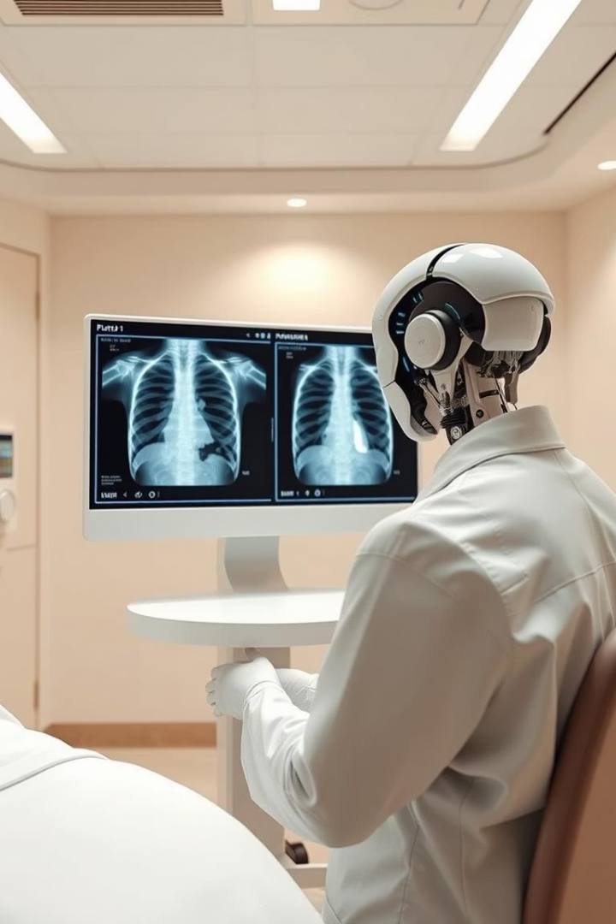
Enhancing Automated Chest Radiology Report Generation
This presentation a system combining LLMs and Knowledge graphs to improve automated chest radiograph (CXR) report generation. The system addresses challenges in semantic richness and visual grounding by integrating flexible KG construction, hybrid similarity metrics, and retrieval-augmented generation (RAG).

Slide 2
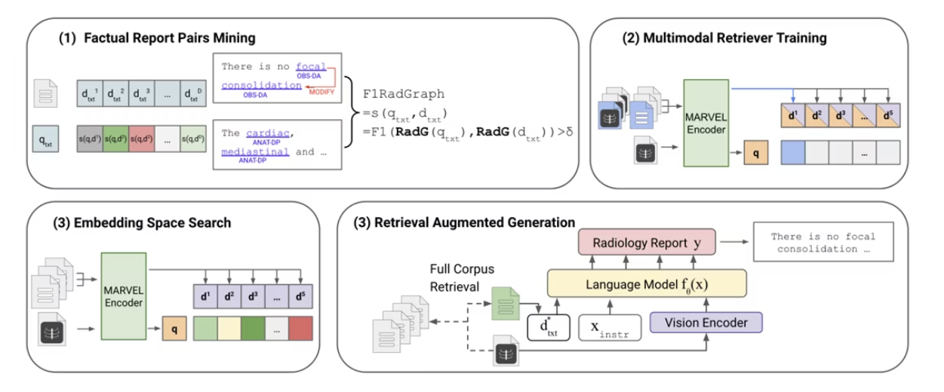
Fact-Aware Multimodal Retrieval Augmentation for Accurate Medical Radiology Report Generation
Construction: Fixed Schema
Retrieval: Retrieval based on Jaccard similarity
Generation: Provide only 1 example as a context for LLM.

Slide 3
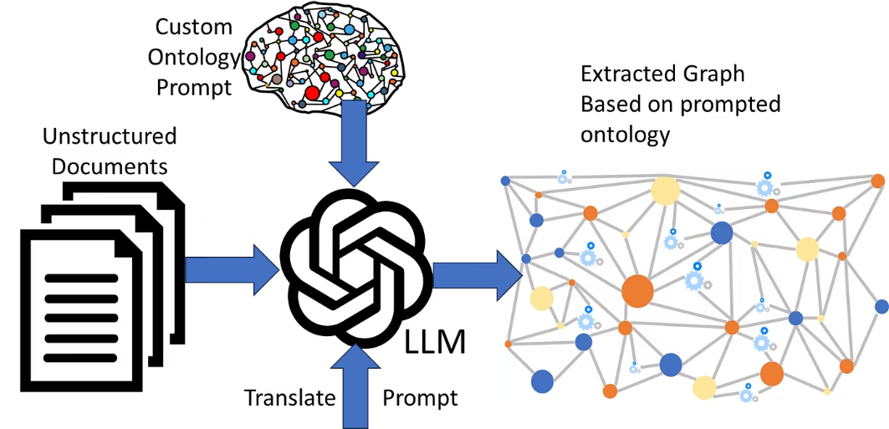
Phase 1: LLM-Driven Knowledge Graph Construction
1
Flexible KG Creation
2
Entity & Relation Extraction
3
Graph Aggregation & Normalization
.

Slide 4
Phase 2: Retrieval
KG Database
Hybrid Similarity Metric
Contrastive Learning
Storing all of report embeddings , entities and relaxations in a neo4j database.
Combines cosine similarity of embeddings with Jaccard similarity of KG entities, balancing semantic and structural alignment for robust learning. Calculating the similarity with every and each pair of reports.
Pulls matched image-report pairs closer while pushing apart non-matched pairs, enhancing embedding space quality.

Slide 5
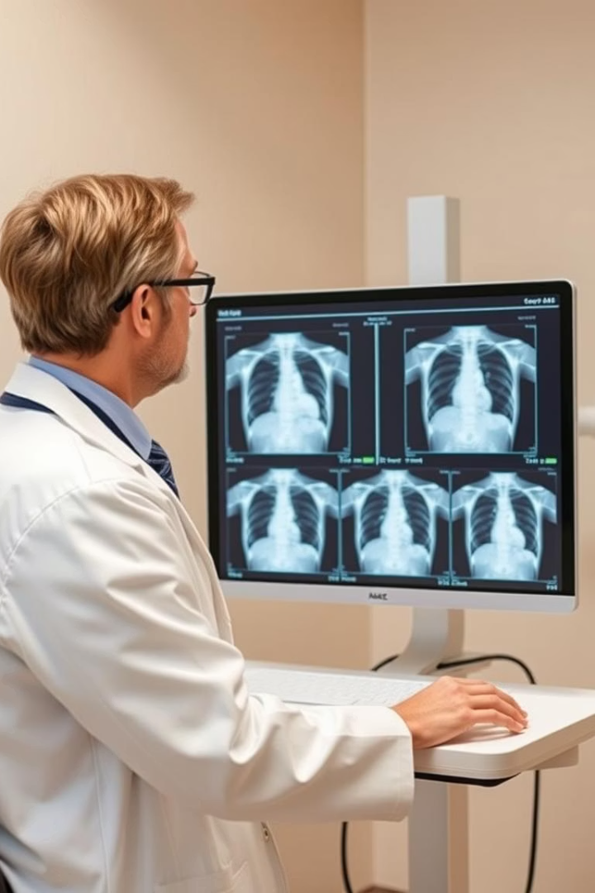



Phase 3: Generation
Embedding & Similarity Search
New CXR images are embedded and compared to training set embeddings using cosine similarity for retrieval.
Top-3 Report Retrieval
Three most similar image-report pairs are retrieved to provide diverse, relevant context for generation.
LLM Prompting & Report Generation
LLM uses retrieved reports as examples to generate accurate, context-aware findings for the input CXR.

Slide 6
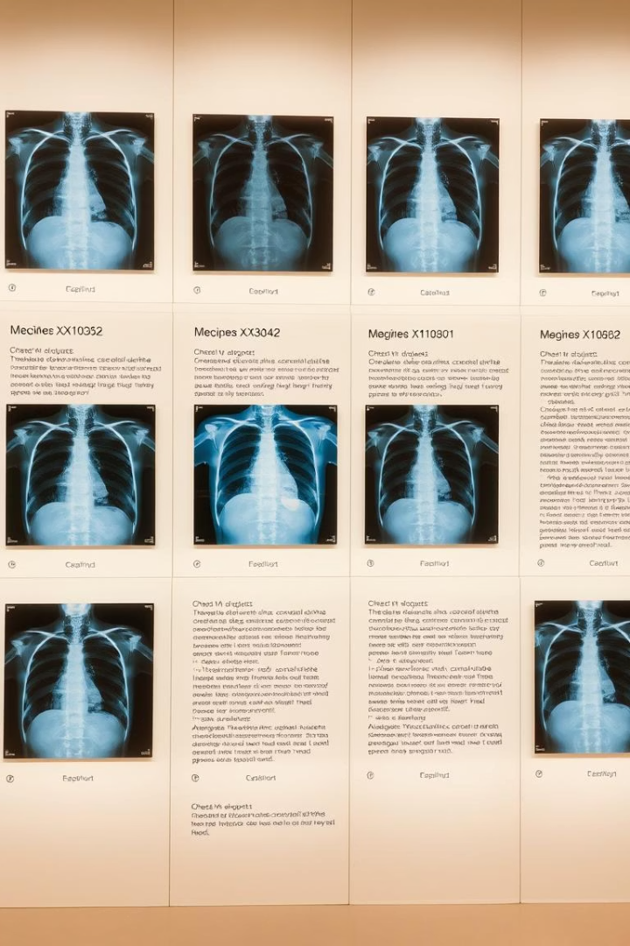
Evaluation Dataset and Metrics
MIMIC-CXR Dataset
Linguistic Metrics
Contains 377,110 de-identified chest X-ray images with free-text reports, split into train, validation, and test sets for benchmarking.
BLEU, ROUGE-L, and CIDEr assess fluency and content overlap but may miss clinical accuracy nuances.
Clinical Accuracy Metric
RadGraph F1 score evaluates overlap of extracted entities and relations, directly measuring clinical correctness.

Slide 7
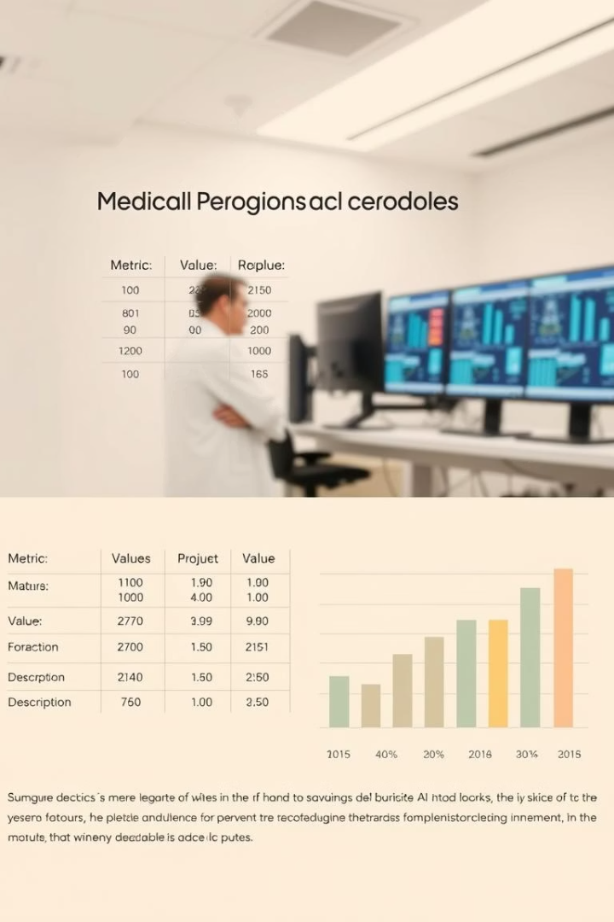
Performance Comparison on MIMIC-CXR
Method
B-1
B-4
ROUGE-L
CIDEr
RadGraph F1
CNN-Transformer RAG (Text Sim)
0.40
0.25
0.36
0.30
0.32
Ours (LLM-KG-Hybrid)
0.47
0.32
0.43
0.40
0.41
Our approach outperforms baselines across all metrics, notably improving clinical accuracy with a RadGraph F1 of 0.41, reflecting better identification of findings and relations.

Slide 8
Ablation Study on Hybrid Similarity
Embedding Similarity
Jaccard Similarity
Hybrid Similarity
High semantic similarity (0.8741) but may retrieve structurally incorrect reports missing key entities.
Focuses on entity overlap (0.6333) but can miss semantically relevant reports with different phrasing.
Balances both (0.8018), yielding highest RadGraph F1 (0.41) and better clinical retrieval and generation.

Slide 9

Key Contributions and Innovations
Schema-Agnostic KG Construction
Hybrid Similarity Metric
Diverse Context Retrieval
Uses LLMs to flexibly extract diverse clinical knowledge without rigid ontologies.
Combines semantic and structural signals for robust embedding learning and retrieval.
Retrieves three examples to provide richer context, reducing bias and improving generation quality.

Slide 10
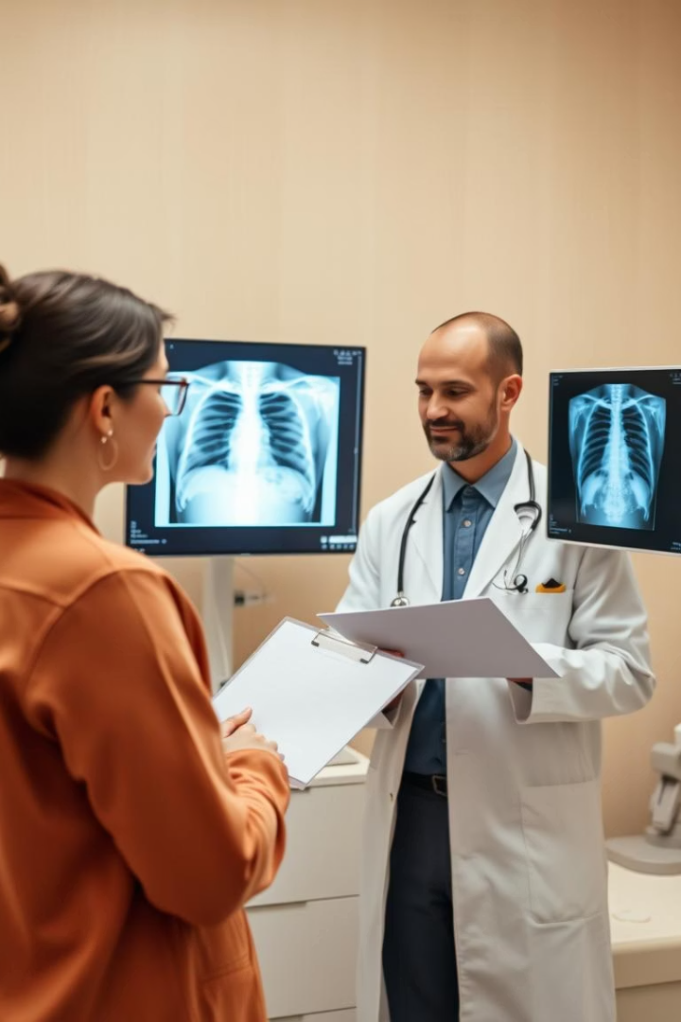
Challenges and Future Directions
Advanced LLM Prompting
Explore fine-tuning and better prompts for nuanced KG extraction, especially handling uncertainty and comparisons.
Embedding Model Enhancements
Investigate alternative GNN architectures and training strategies for improved multi-modal embeddings.
Human-in-the-Loop Evaluation
Engage radiologists to assess clinical utility and identify pitfalls in generated reports.
Ensuring Report Consistency
Develop mechanisms to prevent contradictions between generated reports and image analysis findings.

Slide 11
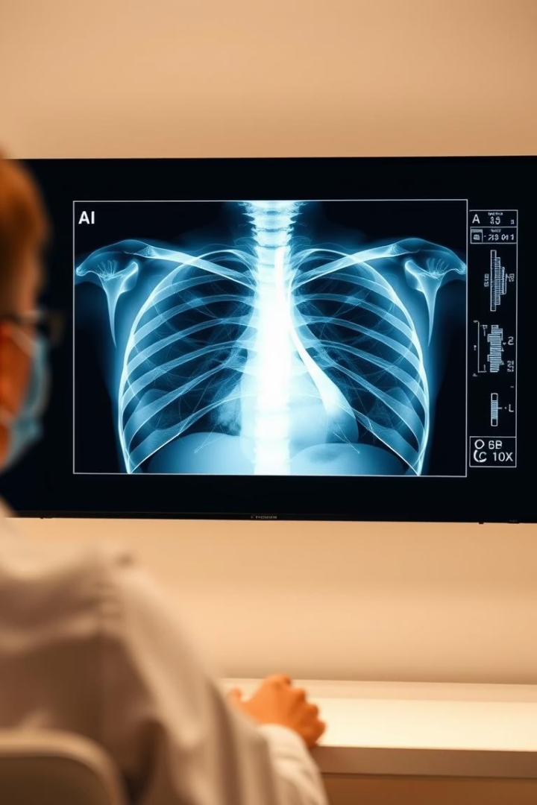
Summary and Impact
This work presents a synergistic system integrating LLM-driven knowledge graphs, hybrid similarity metrics, and multi-example retrieval to enhance automated chest radiology report generation.
Results demonstrate improved linguistic quality and clinical accuracy, marking a significant step toward reliable AI-assisted radiology. Continued research and validation are essential for clinical adoption, promising to alleviate radiologist workload and improve diagnostic workflows.

